Slide 1
DRL-Based Heading Control and Path Following of a Ship in Calm Water & Waves

Slide 2
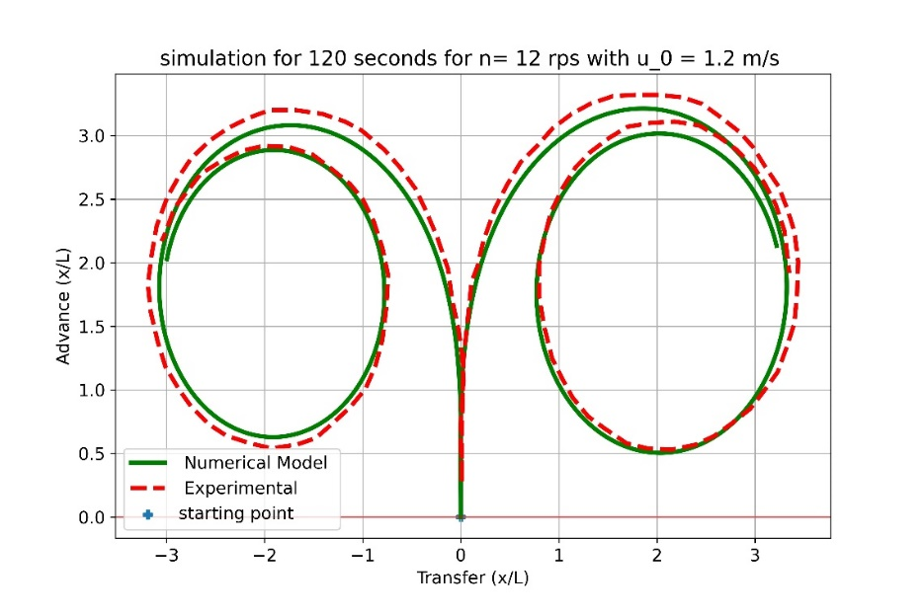
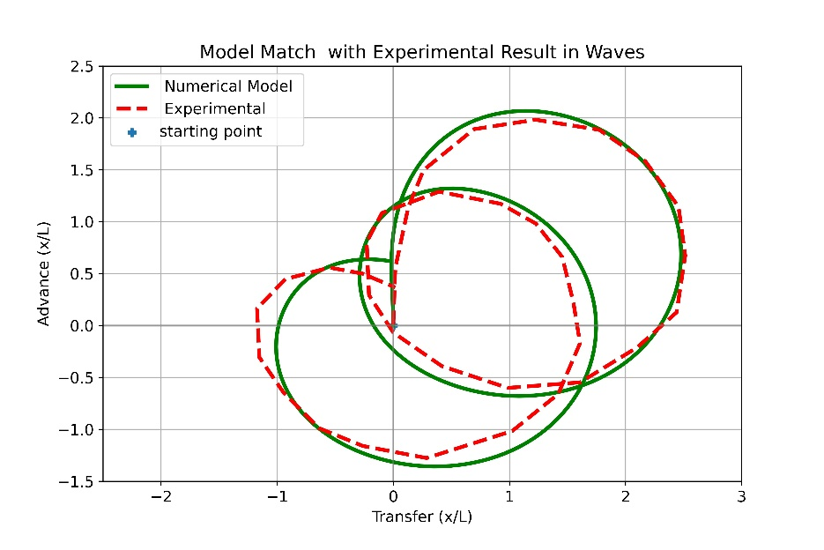
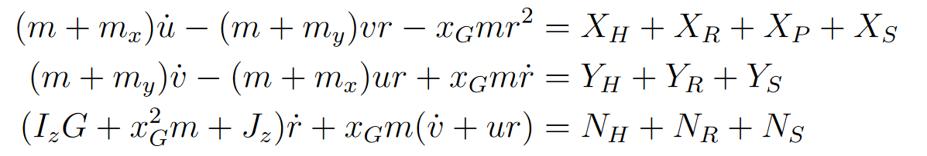
KVLCC2 Tanker trajectory in calm water and Waves
Governing Equation :

Slide 3
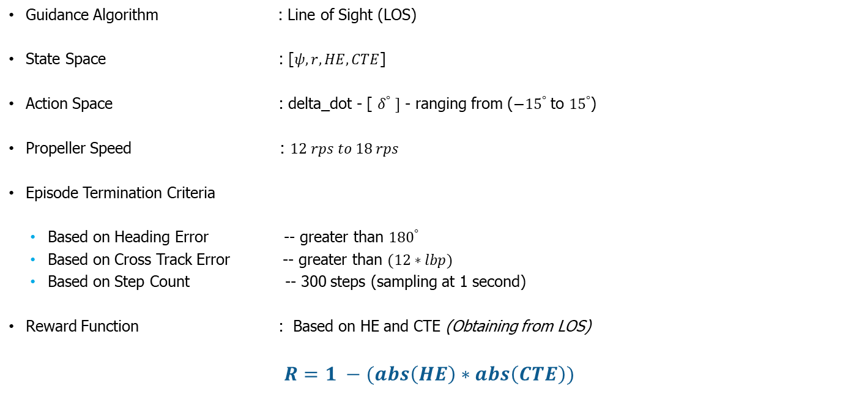
Environment Setup
Guidance Algorithm : Line of Sight (LOS)
State Space : [$ψ,r,HE,CTE$]
Action Space : delta_dot - [ $δ^{°} ]$ - ranging from ($−{15}^{°}$ to ${15}^{°}$)
Propeller Speed : $12 rps to 18 rps$
Episode Termination Criteria
Based on Heading Error -- greater than ${180}^{°}$
Based on Cross Track Error -- greater than $(12∗lbp)$
Based on Step Count -- 300 steps (sampling at 1 second)
Reward Function : Based on HE and CTE (Obtaining from LOS)
$R=1 −(abs\left(HE\right)∗abs\left(CTE\right))$

Slide 4
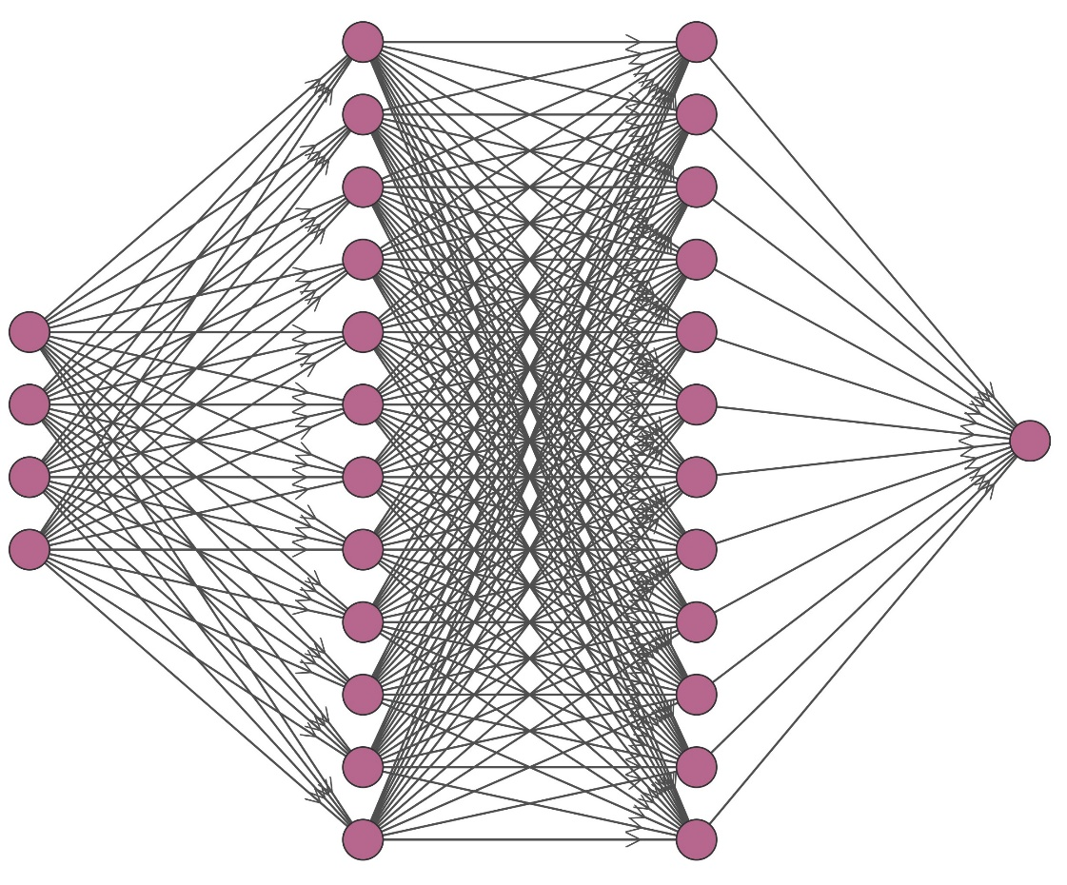





Neural Network Architecture:
$$ψ$$
$$r$$
…96 Nodes…
…96 Nodes…
$$δ^{°}$$
$$HE$$
$$CTE$$

Slide 5
Deep Reinforcement Learning Algorithms
The following Deep Reinforcement Learning Algorithms have been trained in calm water and waves. Finally, the results were compared.
Asynchronous Advantage Actor Critic (A3C)
Deep Deterministic Policy Gradient (DDPG)
Proximal Policy Optimization (PPO)
Soft Actor Critic (SAC)
Twin Delayed Deep Deterministic Policy Gradient (TD3)

Slide 6

Proximal Policy Optimization (PPO)
$learning Rate =0.003$
$β_{1}, β_{2} =0.9, 0.999$
$ε =1e-05$
$batch size =64$
No of epoch $=10$
Clipping range = {-0.2,0.2}

Slide 7
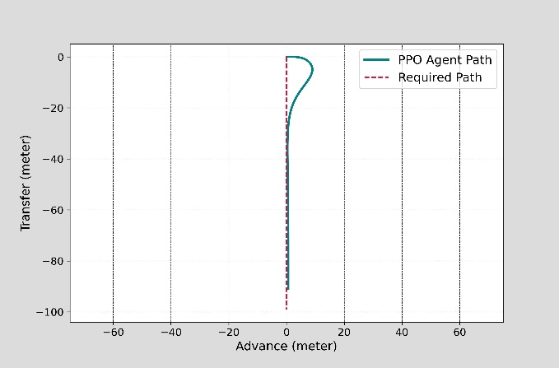
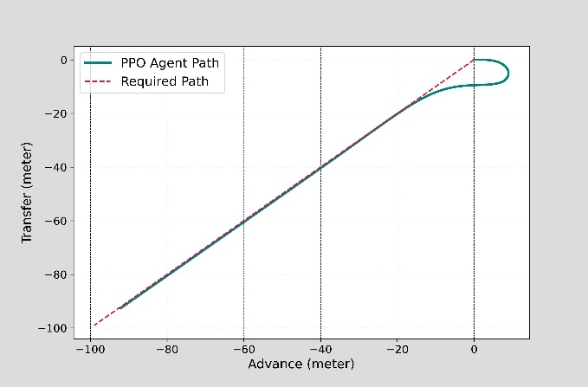
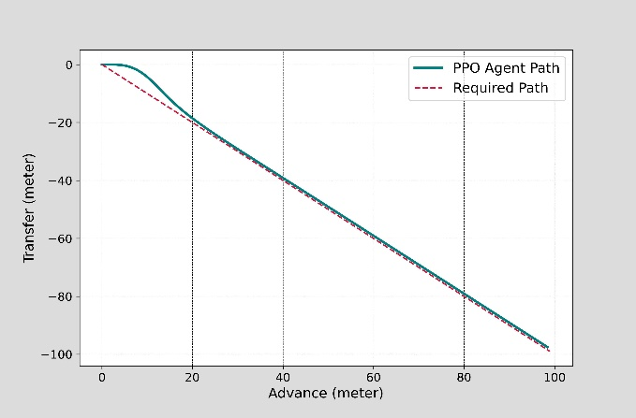
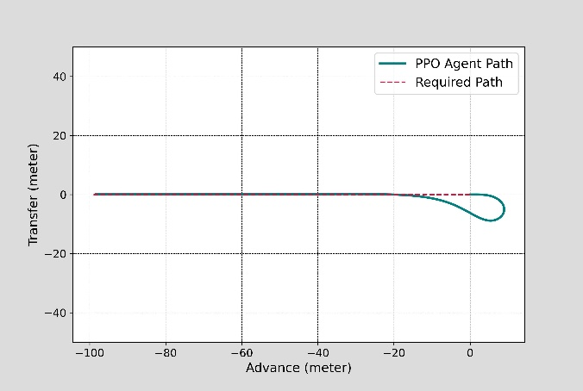
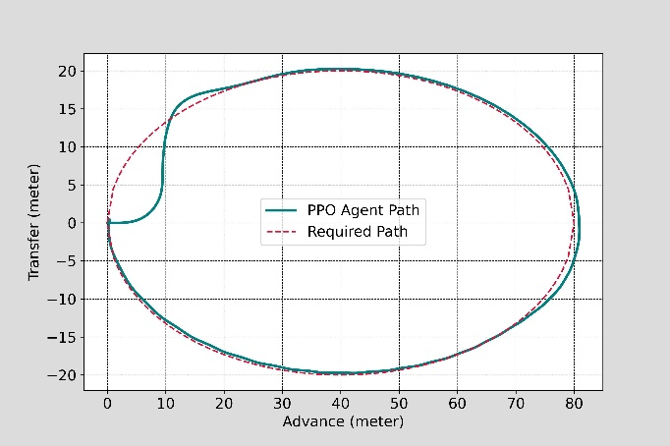
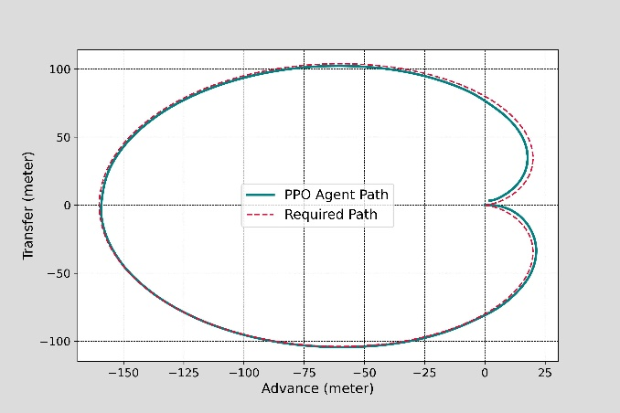
Proximal Policy Optimization (PPO) Results
Path Following Images : ${Heading Action : 45}^{°}$- ${90}^{°}$- ${135}^{°}$- ${180}^{°} −Ellipse −Cardioid$

Slide 8
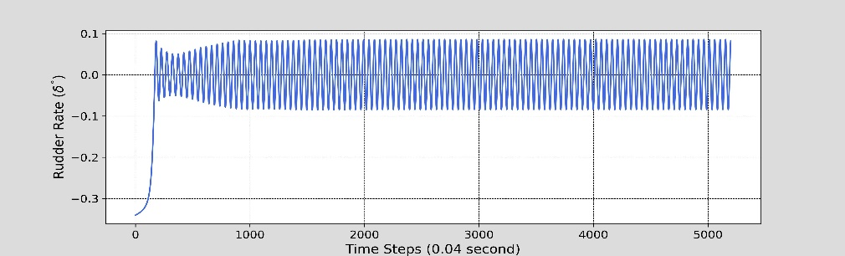
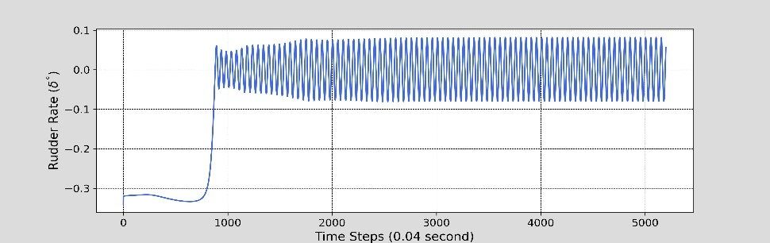
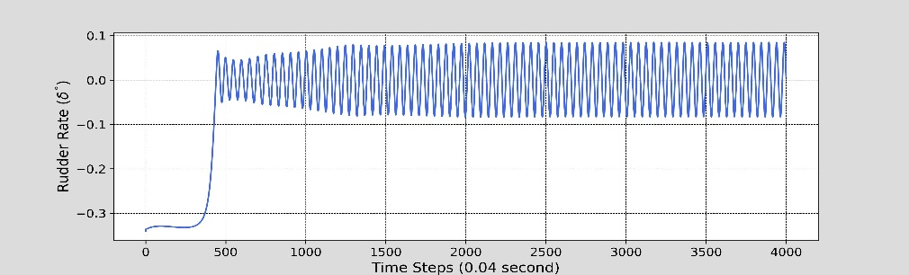
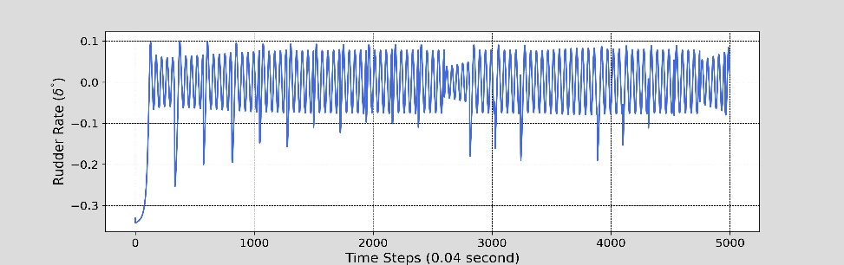
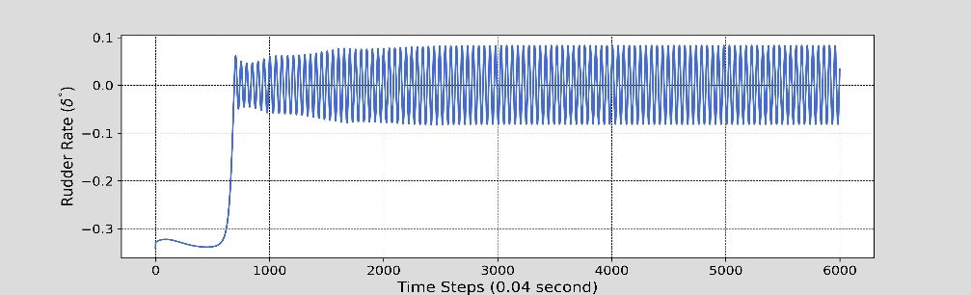
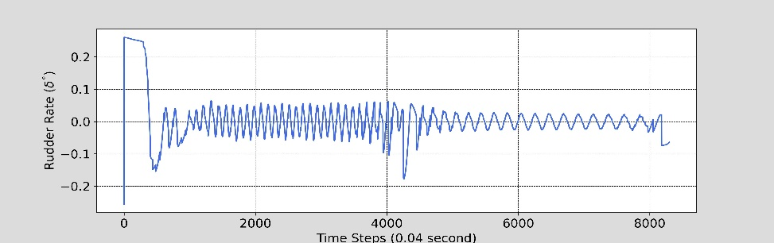
Proximal Policy Optimization (PPO) Results
Rudder Action Images : ${Heading Action : 45}^{°}$- ${90}^{°}$- ${135}^{°}$- ${180}^{°} −Ellipse −Cardioid$

Slide 9
Deep Deterministic Policy Gradient (DDPG)

Slide 10
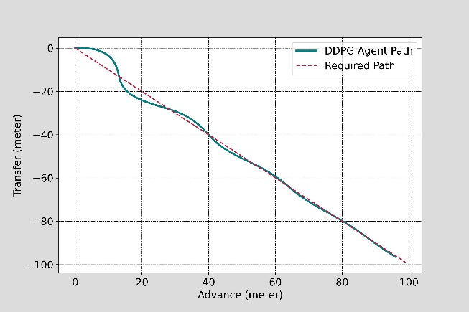
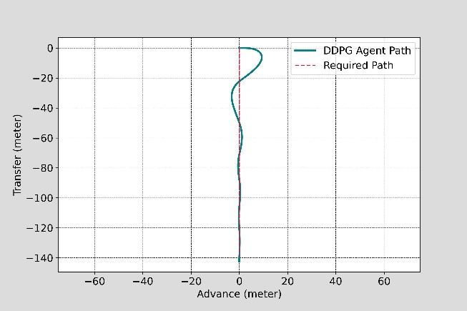
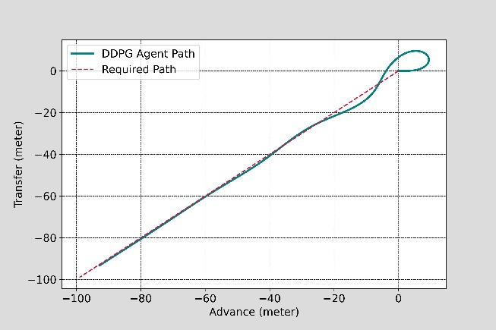
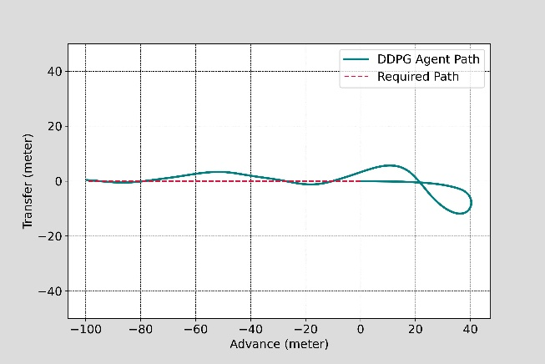
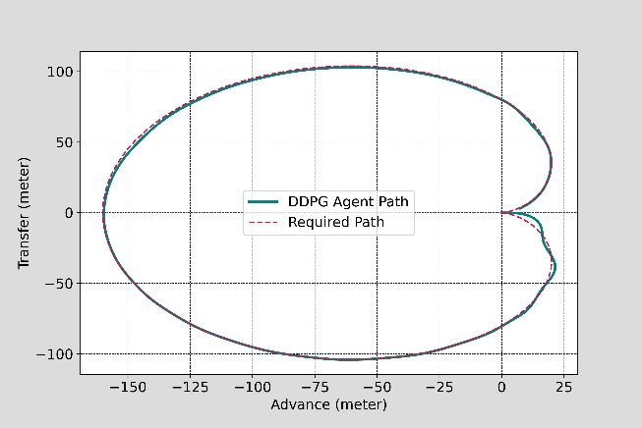
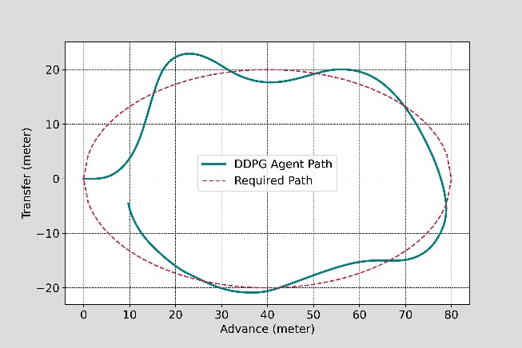
DDPG Results – 1 – Path Following

Slide 11
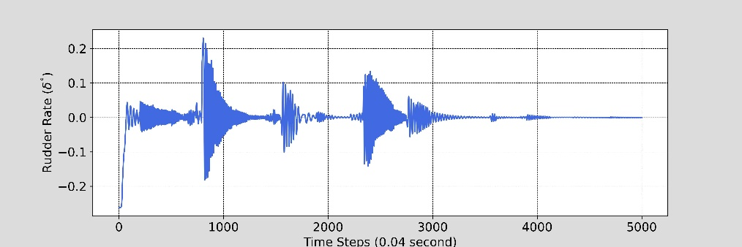
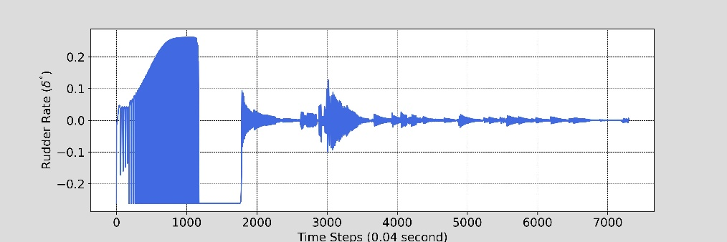
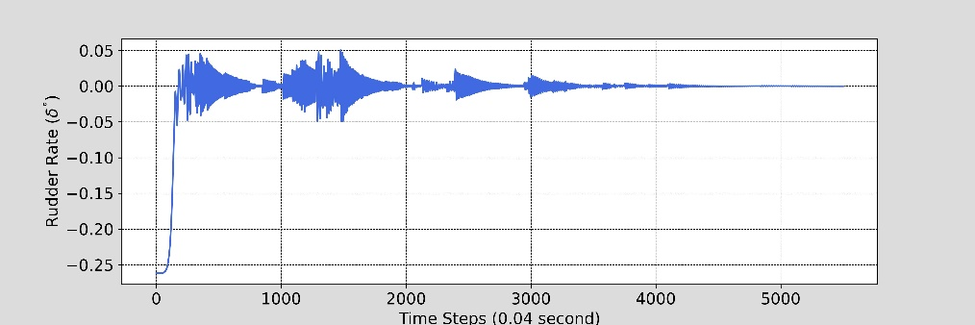
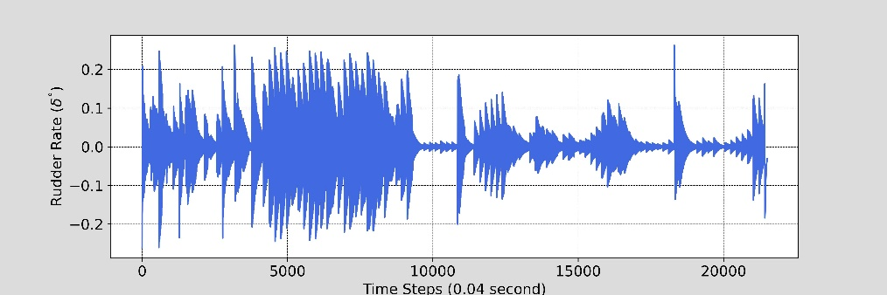
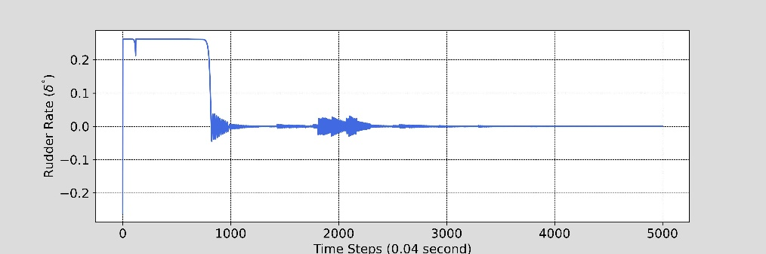
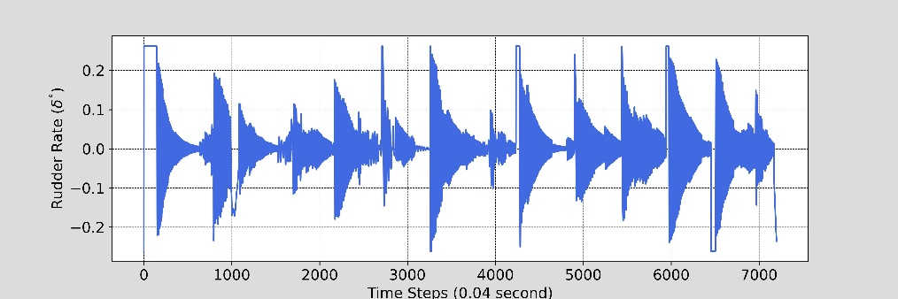
DDPG Results – 2 – Control Command

Slide 12
Soft Actor Critic (SAC)

Slide 13
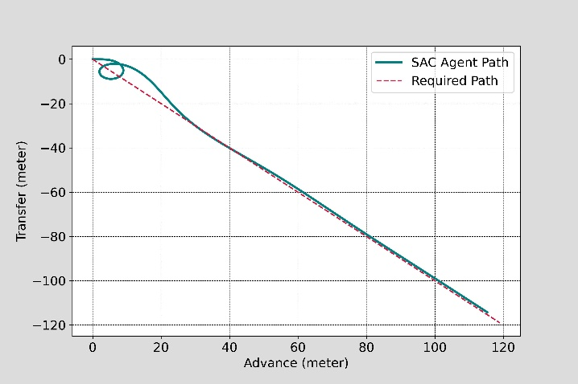
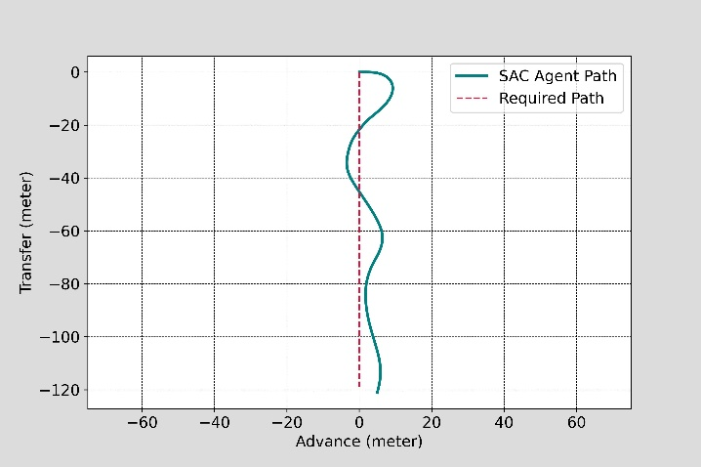
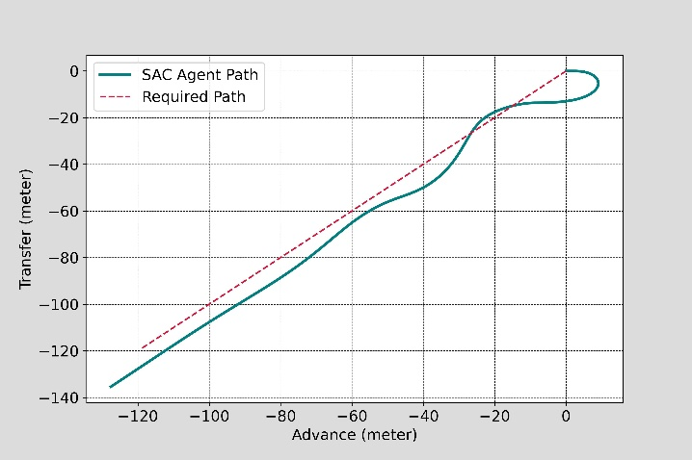
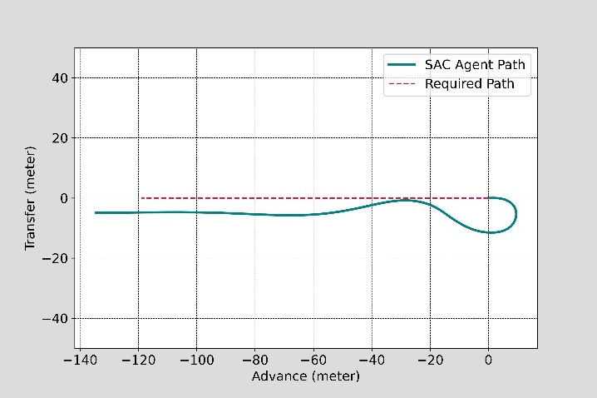
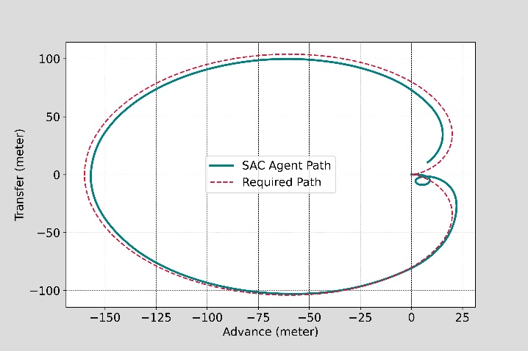
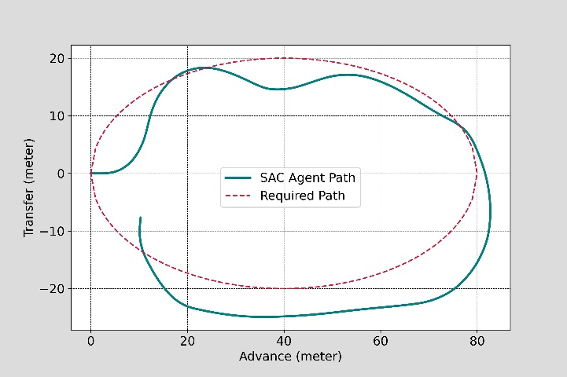
SAC Results - 1

Slide 14
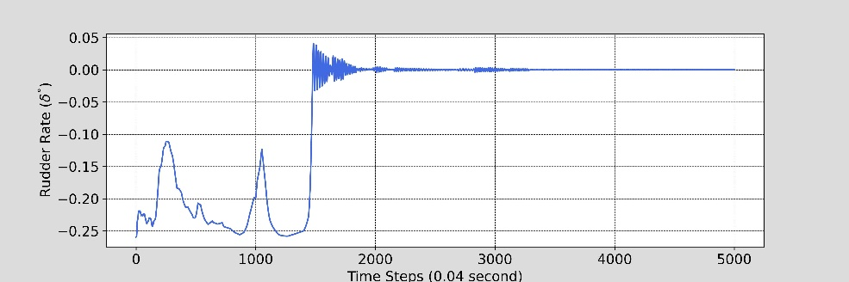
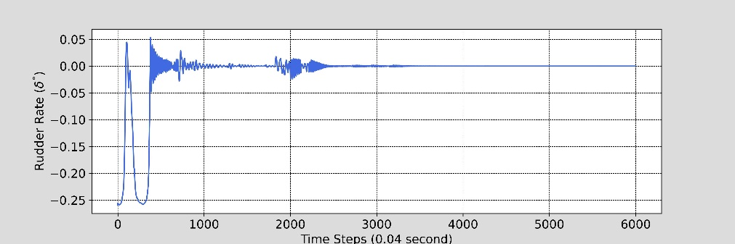
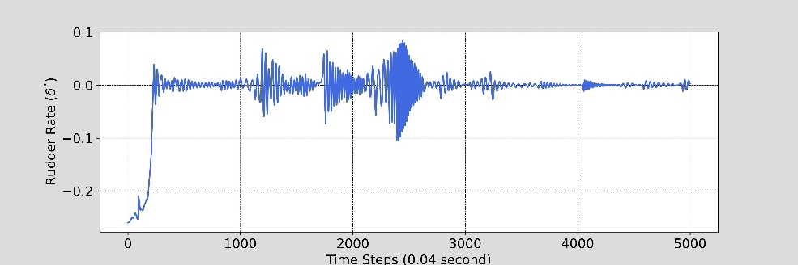
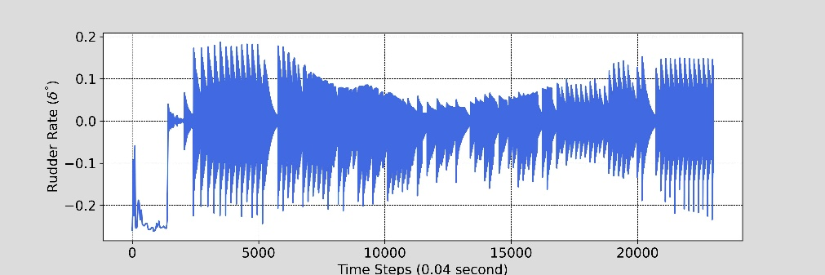
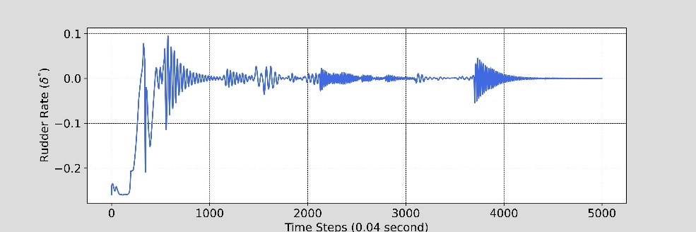
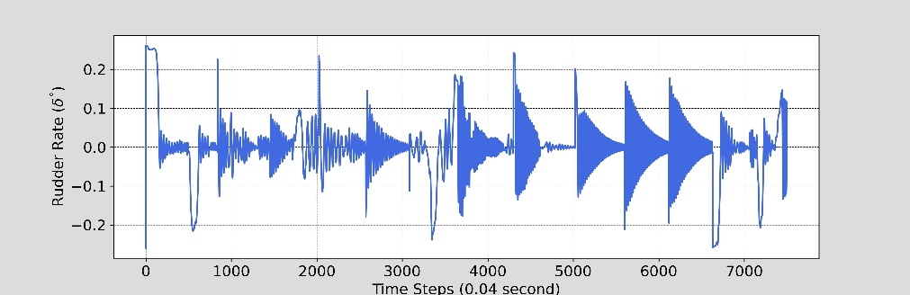
SAC Results - 2

Slide 15
Twin Delayed Deep Deterministic Policy Gradient (TD3)

Slide 16
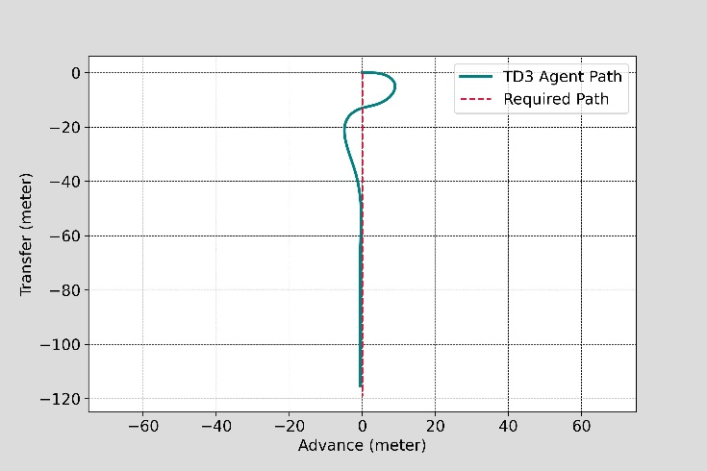
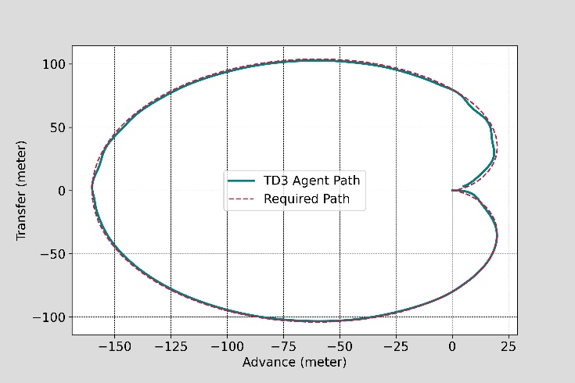
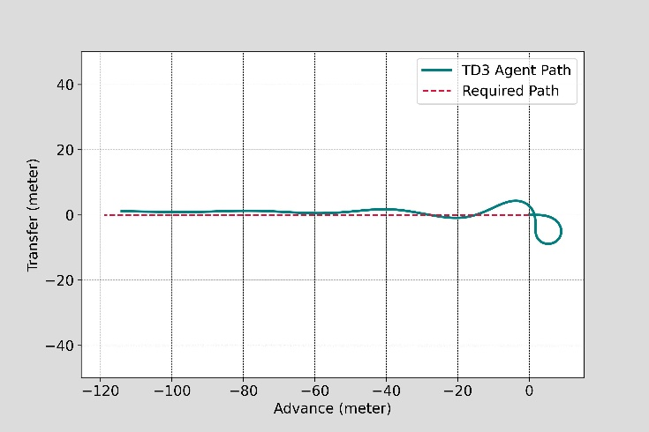
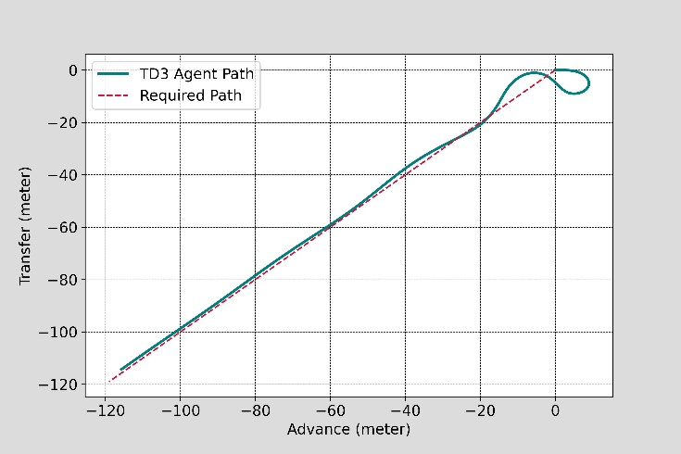
TD-3 Results-1

Slide 17
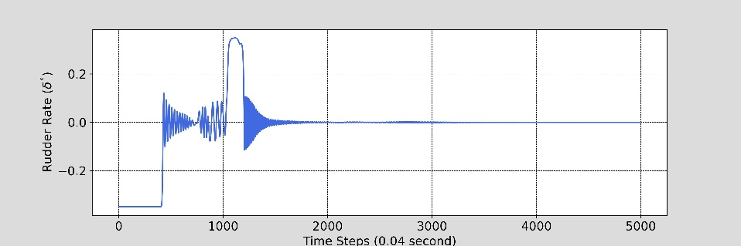
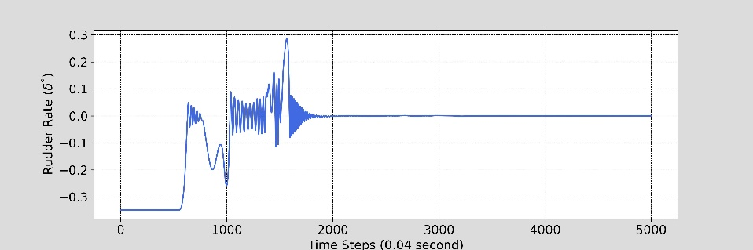
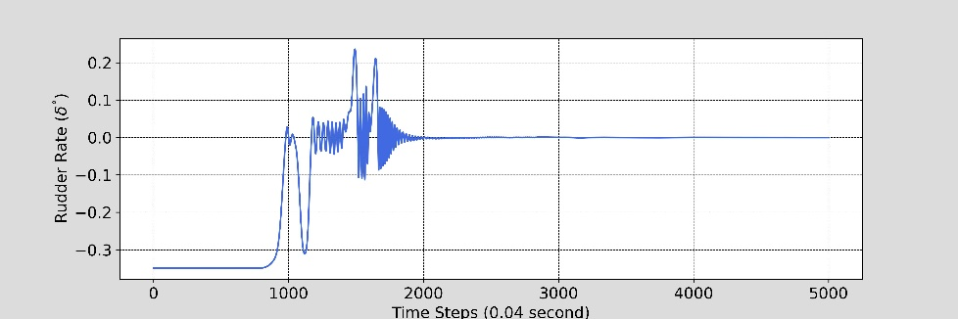
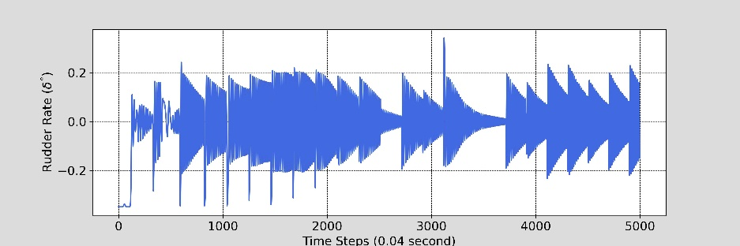
TD3 – Results 2

Slide 18

Reward Comparison

Slide 19

Average Cross Track Error (in Calm Water Condition)
Test Conditions | DDPG | PPO | SAC | TD3
$${45}^{°} Heading$$ | 1.172 | 0.544 | 1.752 | 1.650
$${90}^{°} Heading$$ | 2.011 | 1.607 | 4.098 | 2.494
$${135}^{°} Heading$$ | 1.650 | 2.439 | 3.175 | 3.351
$${180}^{°} Heading$$ | 3.873 | 2.185 | 5.272 | 2.663
$$Cardioid −r20$$ | 0.934 | 2.155 | 2.237 | 0.782
$$Cardioid −r40$$ | 0.651 | 2.177 | 2.905 | 0.881
$$S−shaped Curved$$ | 0.310 | 0.848 | 3.827 | 0.315
$$Elipse −a40−b20$$ | 3.847 | 0.832 | 5.737 | 6.660
$$Elipse −a20−b10$$ | 6.266 | 1.027 | 7.047 | 4.468
5000-time steps for Heading Control cases and for the other cases steps has been taken until tracing the last point.

Slide 20

Maximum Cross Track Error (in Wave Condition)
Test Track | A2C | DDPG | PPO | SAC | TD3
$${45}^{°} Heading$$
$${90}^{°} Heading$$
$${135}^{°} Heading$$
$${180}^{°} Heading$$
$$Cardioid −r20$$
$$Cardioid −r40$$
$$S−shaped Curved$$
$$Elipse −a40−b20$$
$$Elipse −a20−b10$$

Slide 21
Experimental Approach :

Slide 22
Experimental Results

Slide 23
Conclusion

